Slide 1
BUDGET SALES ANALYSIS
Presented By: Vrushali Kolamkar

Slide 2
Problem Statement
Our "Domain Sale" process is structured to help potential buyers purchase the domain they want immediately without the hassle of contacting the seller directly.
A seller lists a domain for sale at a specific price in our Marketplace. An interested buyer sees this domain for sale and decides to buy it.

Slide 3
Objective
The collection includes records for sales orders, customer information, product information, and geographical data.
In order to deduce important metrics and patterns in the dataset, this project will use the provided data to perform ETL and data analysis.
Additionally, several visualizations and reports are created to represent significant linkages.

Slide 4
Benefits
Help in making wiser business decisions.
Aid in customer satisfaction and trend monitoring, which can serve current consumers and attract new ones.
Greater client base understanding is provided.
Facilitates seamless resource management flow.

Slide 5

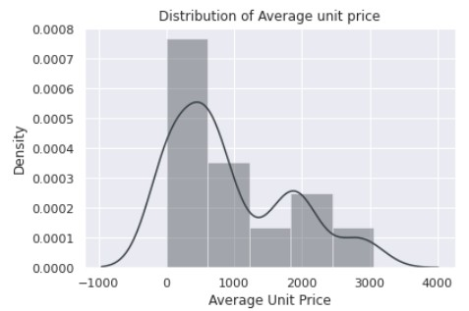

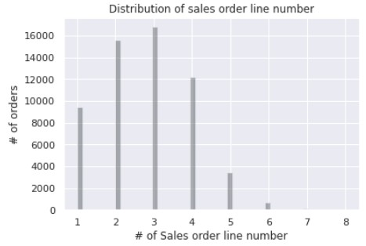
Insights
8
1. Product Price per unit Distribution
 | According to the above distribution plot we can conclude that maximum of the product unit price is below $1000
2. Sales order line number distribution
 | Most of the time three to two products are ordered in a single order
ABHISHEK DOKE
8

Slide 6

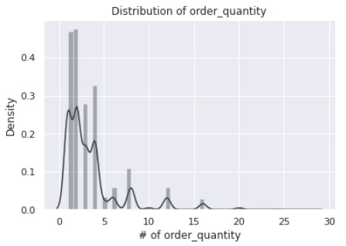

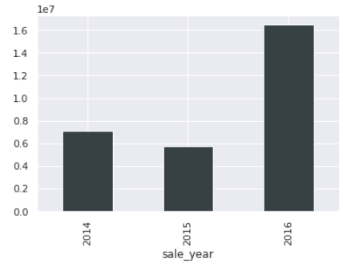

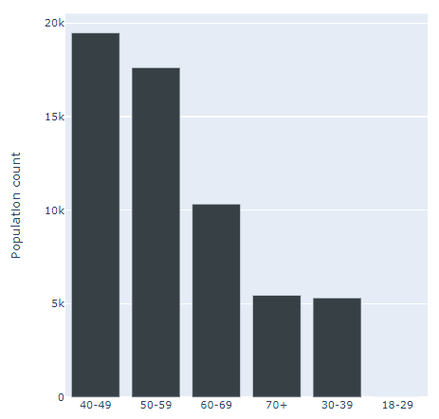
3. Sales order quantity distribution
 | 5. Year wise sales
4. Age distribution
ABHISHEK DOKE
9

Slide 7


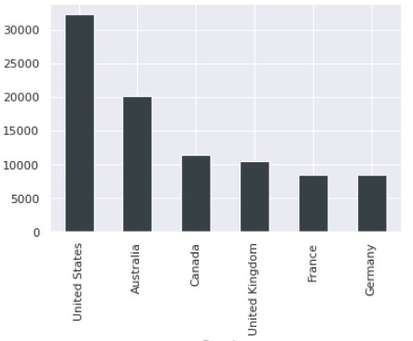
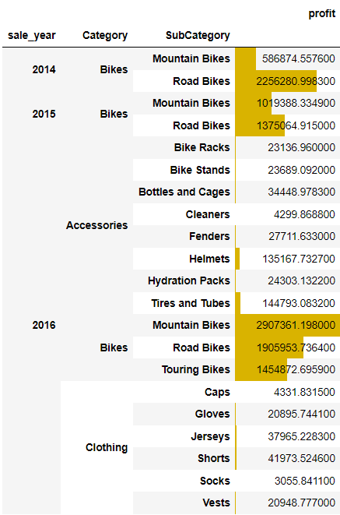
Overall profit based on order year, category and subcategory
Country wise quantity ordered
ABHISHEK DOKE
11

